Slide 1
Customer Segmentation Using RFM Analysis in E-Commerce
Malini Roy Choudhury

Slide 2
Problem Statement and Objective
Problem Statement:
E-commerce businesses generate vast amounts of transactional data but often struggle to leverage it for actionable customer segmentation. Understanding purchasing patterns is crucial for predicting behavior, improving retention, reducing churn, and maximizing customer lifetime value. A structured approach is needed to identify high-value customers, detect trends, and optimize targeted marketing strategies.
Objective:
Utilize the RFM (Recency, Frequency, Monetary) framework to segment e-commerce customers.
Analyze purchasing patterns to identify high-value customers and at-risk segments.
Create targeted marketing strategies to improve customer retention and satisfaction.

Slide 3
Dataset Overview
Source: [Kaggle - E-commerce Dataset]
Size: (541909, 8)
Timeframe: 01/12/2010 to 09/12/2011
Key Variables:
InvoiceNo: Unique transaction ID
StockCode: Unique product identifier
Description: Product description
Quantity: Number of items purchased
InvoiceDate: Timestamp of purchase
UnitPrice: Price per unit in GBP
CustomerID: Unique customer identifier
Country: Location of the customer
Notes:
This is a transnational data set which contains all the transactions occurring between 01/12/2010 and 09/12/2011 for a UK-based and registered non-store online retail.The company mainly sells unique all-occasion gifts. Many customers of the company are wholesalers.

Slide 4
Data Cleaning and Preparation
Handled Missing Values
Removed Duplicates
Removed Cancelled Orders
Removing non-product Stock-Codes

Slide 5
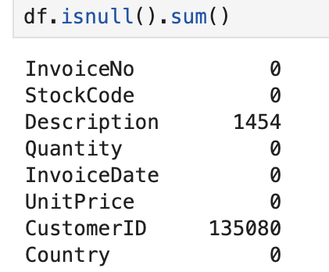
Data Cleaning and Preparation
Handled Missing Values
Removed Duplicates
Removed Cancelled Orders
Removing non-product Stock-Codes
The percentage of missing values in the CustomerID column is 24.93%.
Since the analysis will revolve around investigating customers and clustering them into categories, the missing values in the CustomerIDs were removed.

Slide 6
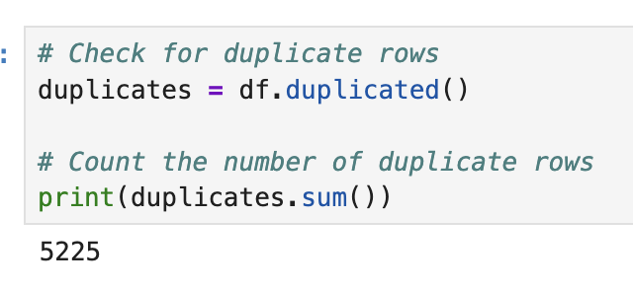
Data Cleaning and Preparation
Handled Missing Values
Removed Duplicates
Removed Cancelled Orders
Removing non-product Stock-Codes
The number of duplicate rows in the dataset is 5525.
These rows were removed from the dataset.

Slide 7
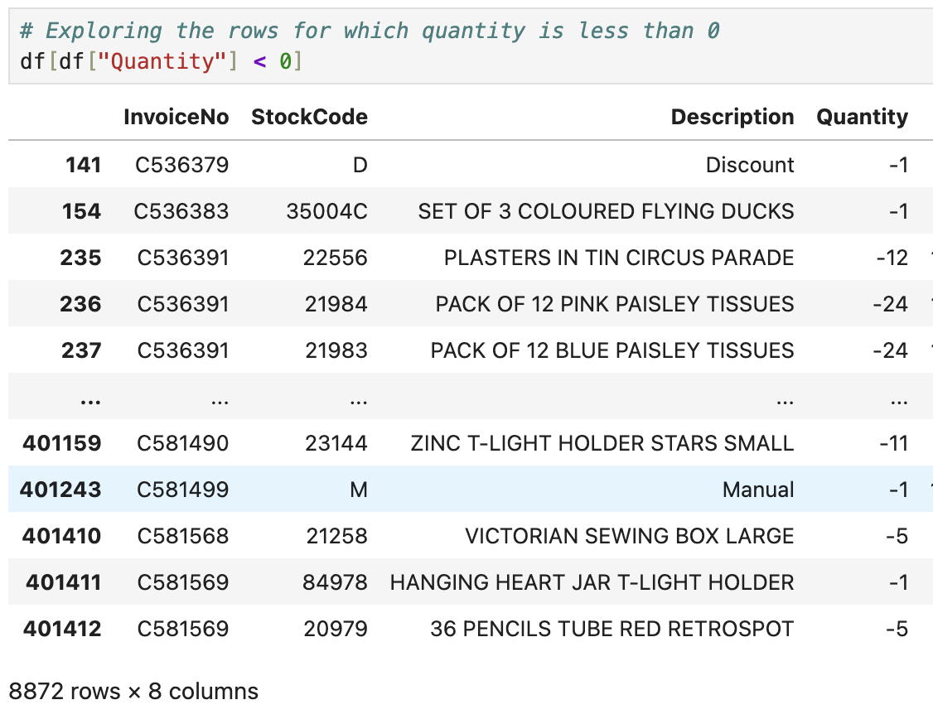
Data Cleaning and Preparation
Handled Missing Values
Removed Duplicates
Removed Cancelled Orders
Removing non-product Stock-Codes
There are 8872 rows for which the quantity is negative which can be either due to data-entry errors or return orders or cancelled orders.
If we look at the InvoiceNo for all these cases, they start with the letter ‘C’ which indicates they are cancelled orders. Thus these rows were removed from the dataset

Slide 8
Data Cleaning and Preparation
StockCodes | Description
POST | POSTAGE
C2 | CARRIAGE
M | MANUAL
DOT | DOTCOM POSTAGE
BANK CHARGES | BANK CHARGES
Handled Missing Values
Removed Duplicates
Removed Cancelled Orders
Removing non-product Stock-Codes
There are certain StockCodes which do not belong to any products. All the rows containing such StockCodes were removed.

Slide 9
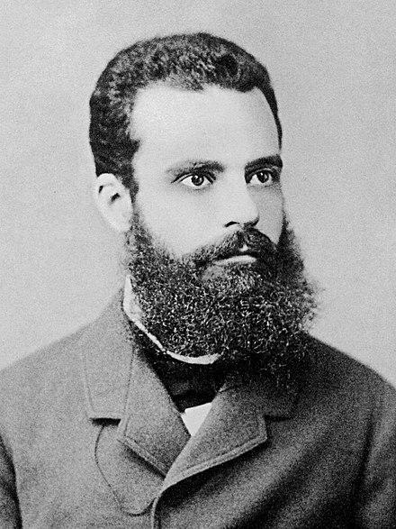
Pareto Principle
Roughly 80% of outcomes stem from 20% of causes

Slide 10
26%
Customers contribute to 80% of the revenue.

Slide 11
21%
Products contribute to 80% of the revenue.

Slide 12
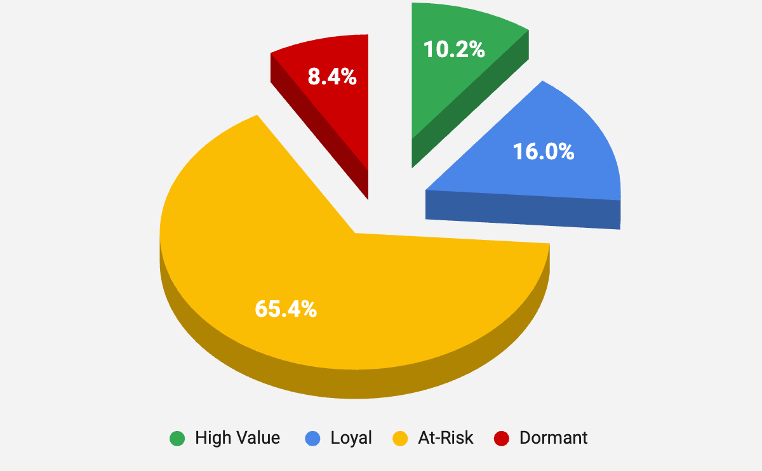
RFM Analysis and Customer Segmentation
Customer Segments Based on RFM Score
What is RFM?
Recency (R): Days since last purchase
Frequency (F): Number of purchases
Monetary (M): Total spending
Customers are segmented into five equal buckets based on Recency, Frequency, and Monetary values. Each customer is ranked for each metric, assigned a score from 1 to 5, and their scores are summed to derive an overall RFM score for analysis.

Slide 13
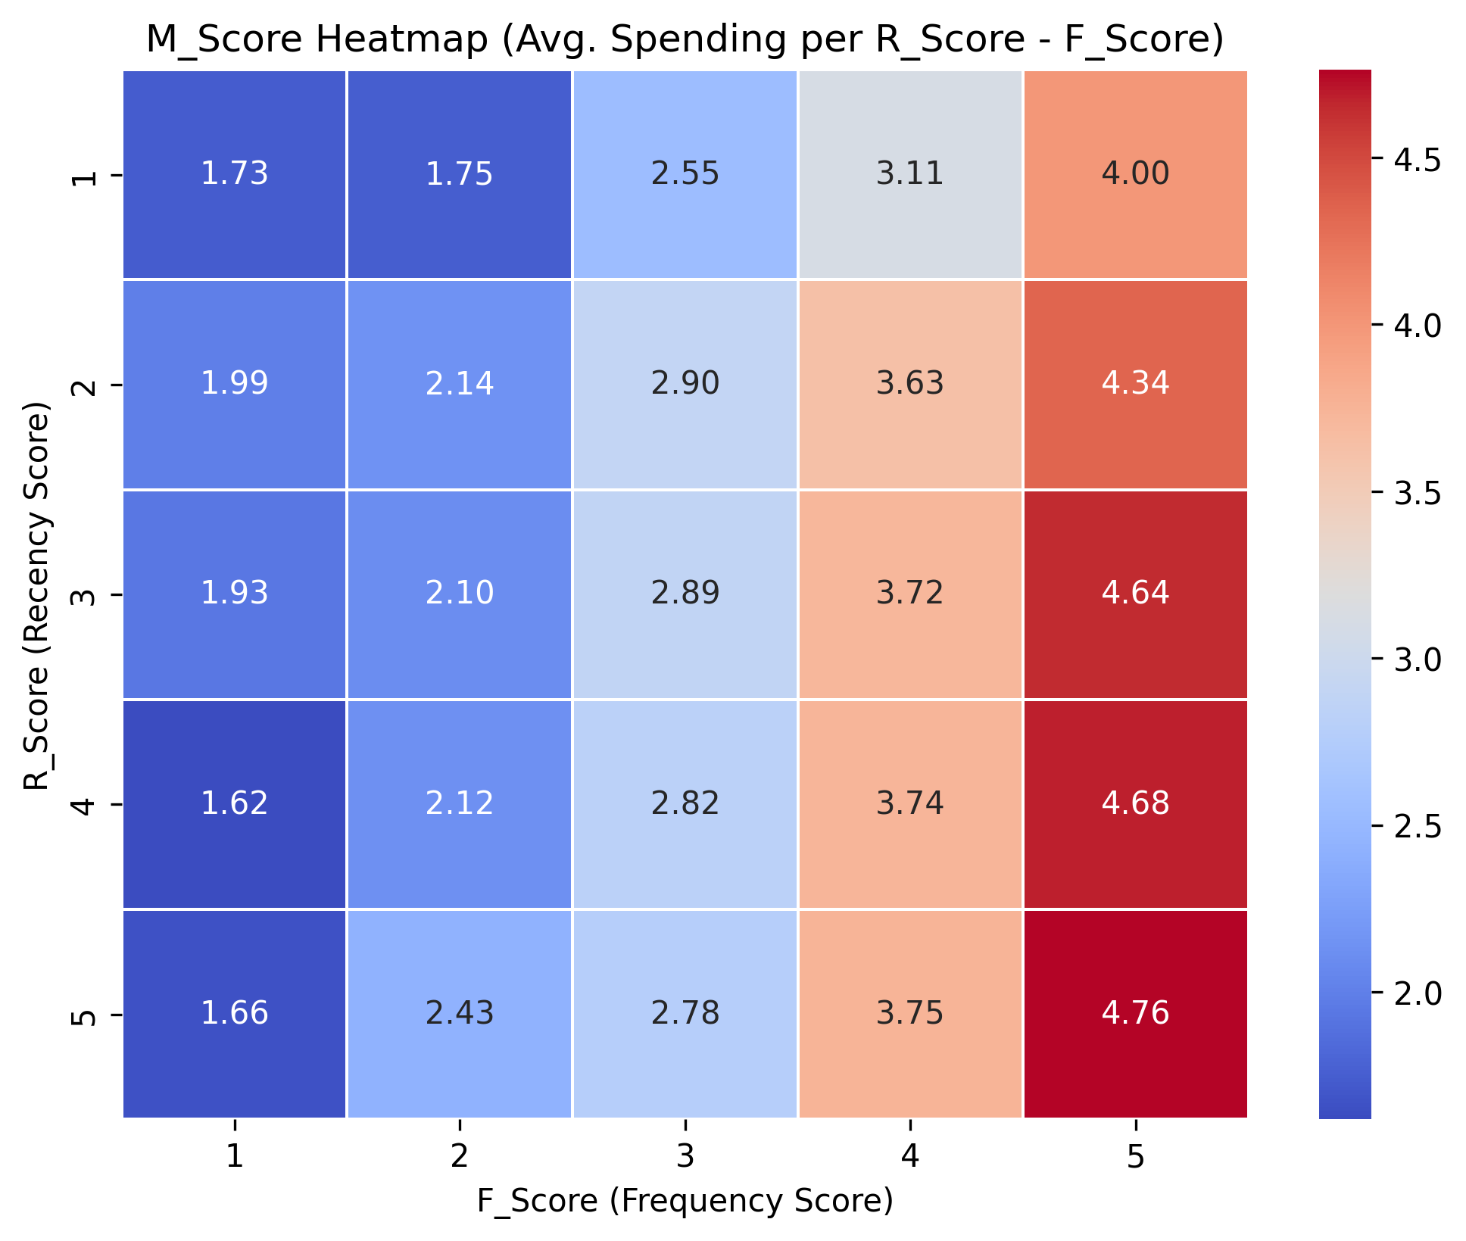
Heat Map based on RFM Score

Slide 14
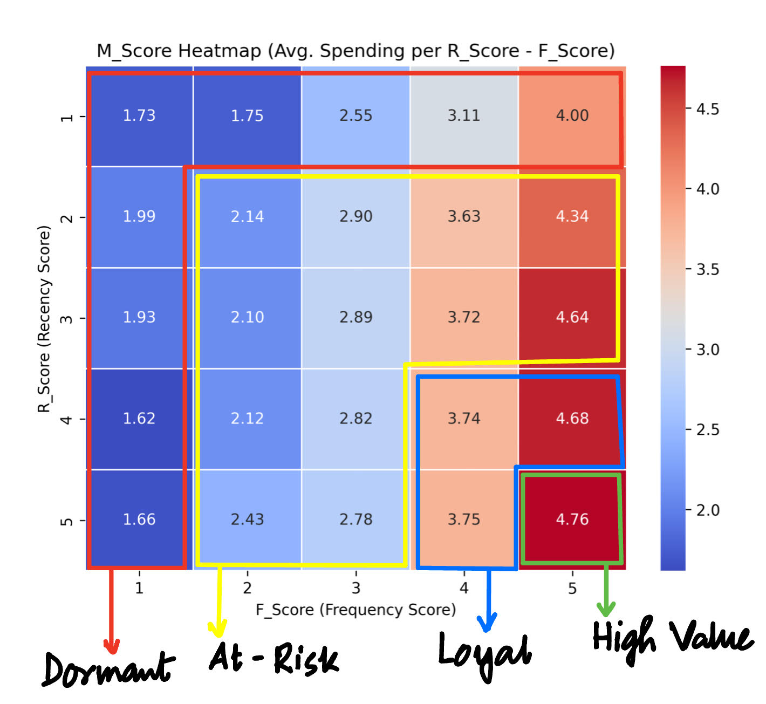
RFM Analysis and Customer Segmentation
Based on this RFM Score Analysis, we have four customer segments: 1. High Value Customers
2. Loyal Customers
3. At-Risk Customers
4. Dormant Customers

Slide 15
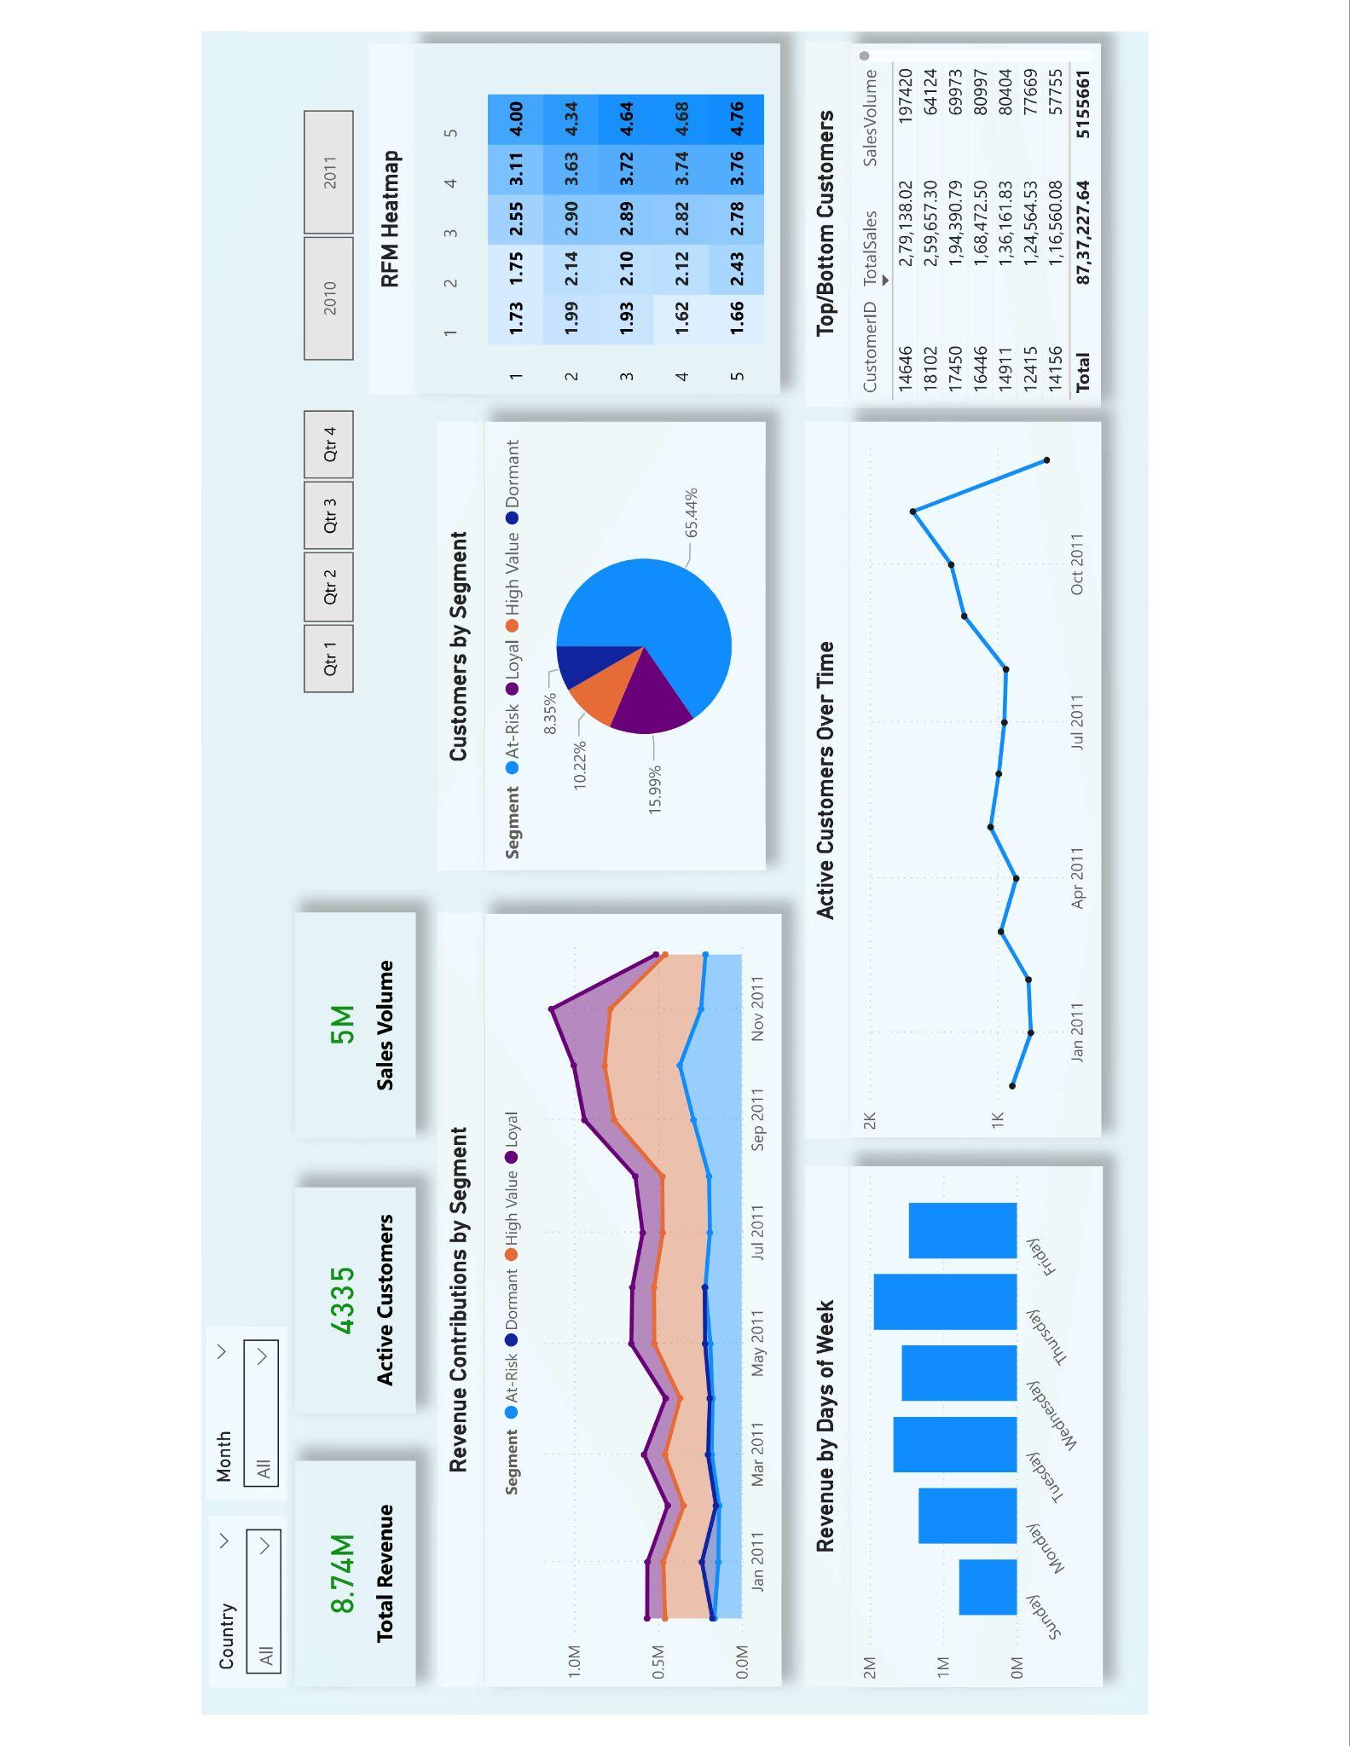
Dashboard

Slide 16
Recommendations Based on Segments
Customer Segments Based on RFM Score
High Value Customers
Characteristics: Brand advocates with exceptional engagement and spending.
Behaviour: Low Recency (recent purchases), High Frequency, High Monetary.
Strategy: Reward with loyalty programs and exclusives.

Slide 17
Recommendations Based on Segments
Customer Segments Based on RFM Score
Loyal Customers
Characteristics: Consistent buyers with moderate activity.
Behaviour: Average Recency, Moderately High Frequency, High Monetary.
Strategy: Upsell/cross-sell opportunities to boost value.

Slide 18
Recommendations Based on Segments
Customer Segments Based on RFM Score
At-Risk Customers
Characteristics: Not-so Consistent buyers
Behaviour: Moderately High Recency, Low Frequency, Variable Monetary.
Strategy: Personalized emails and Limited-time promotions to regain interest.

Slide 19
Recommendations Based on Segments
Customer Segments Based on RFM Score
Dormant Customers
Characteristics: Declining engagement with potential churn risk.
Behaviour: High Recency, Below Average Frequency, Low Monetary.
Strategy: Win-back campaigns or surveys to address dissatisfaction.

Slide 20

Thanks!
Contact:
Malini
Malini.rchoudhury@gmail.com

